Slide 1

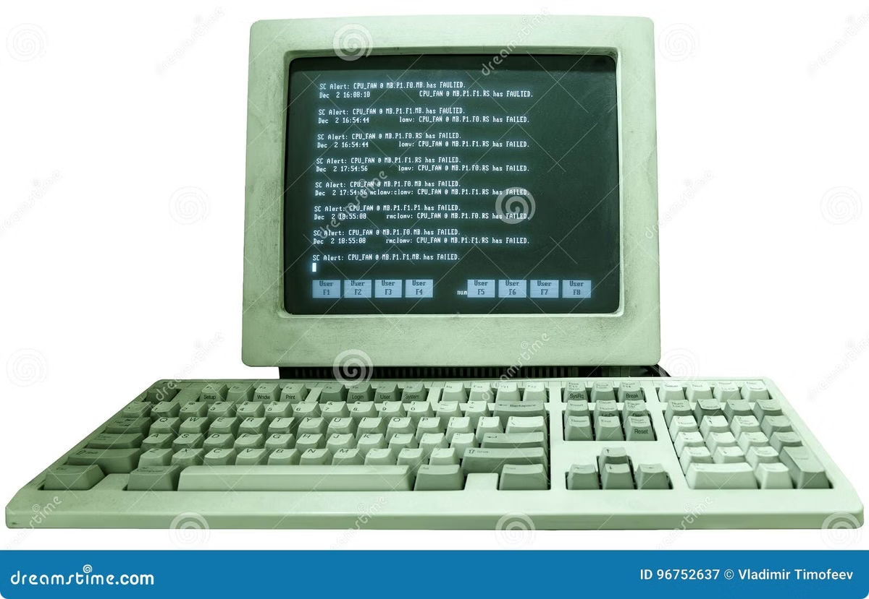
The Marquee Tag: A Blast from the Past
The `` tag is a legacy HTML element that was popular in the early days of the web for creating scrolling text effects. While still supported by browsers, it's generally not recommended for modern web design.

Slide 2
Usage and Syntax
The `` tag is used to create scrolling text. It takes a single text content. You can use the `direction` attribute to specify the scrolling direction: `left`, `right`, `up`, or `down`. The `behavior` attribute can be set to `scroll`, `slide`, or `alternate`.
Scroll
Slide
Alternate
Continuous scrolling in the specified direction.
The text scrolls once and then stops.
The text scrolls back and forth between the start and end points.

Slide 3

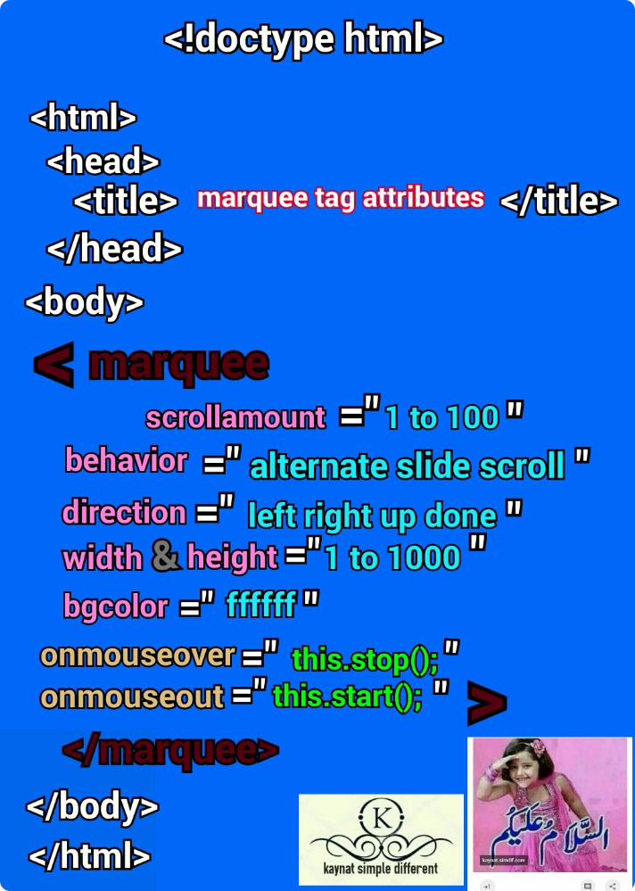
Attributes of the `Marquee` Tag The `Marquee` tag has several attributes to customize its behavior:
DirectionSpecifies the direction of the scrolling text.
BehaviorControls how the text scrolls: `scroll`, `slide`, or `alternate`.
LoopDetermines how many times the text scrolls. A value of -1 indicates infinite scrolling.
ScrolldelaySets the delay in milliseconds between scrolling iterations.

Slide 4

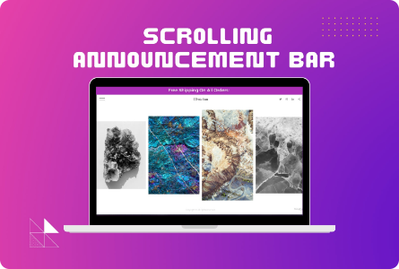
Examples of Marquee Usage
Here are some examples of how the `` tag can be used:
Scrolling Announcement
Ticker Tape
Animated Text
A banner that scrolls across the top of a page to display important announcements.
A classic ticker tape effect that simulates scrolling news or messages.
Creating simple animation effects by moving text across the screen.

Slide 5

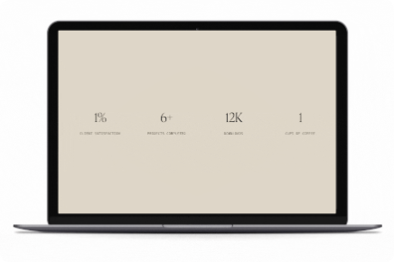



Alternatives to Marquee
Modern web design techniques offer more sophisticated and efficient ways to achieve similar effects:
CSS Animations
JavaScript
Canvas
Provides more control over animation timing, easing, and transitions.
Offers complete control over creating custom animation effects.
Enables drawing and manipulating graphics directly on the web page.

Slide 6


Accessibility Considerations
The `` tag can pose accessibility challenges:
Reading Difficulty
Scrolling text can be difficult for people with visual impairments or cognitive disabilities to read.
Distractions
Moving text can be distracting and disruptive for some users.
Keyboard Navigation
It can be challenging for keyboard users to navigate the content affected by scrolling text.

Slide 7






Best Practices for Modern Web Design
While `` still works, it's generally recommended to use alternative methods for creating scrolling text:
CSS Animations
Provide more control over animation timing, easing, and transitions.
JavaScript
Offer complete control over creating custom animation effects.
Canvas
Enable drawing and manipulating graphics directly on the web page.
Accessibility
Prioritize user experience and avoid creating potentially distracting or inaccessible elements.

Slide 8

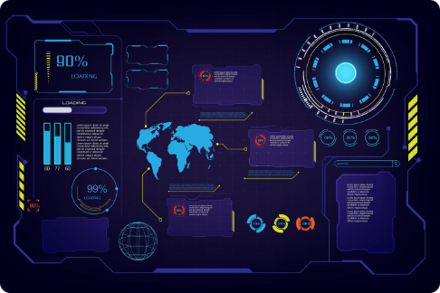
The Future of Marquee
The `` tag might seem outdated, but it's an interesting reminder of the history of web design. While its use is discouraged in modern web development, it serves as a reminder of the evolution of web technologies and the importance of prioritizing accessibility and user experience.

Slide 9

Thank You!
We appreciate your time and consideration.
We hope you found this presentation informative and engaging. If you have any questions or would like to learn more, please don't hesitate to contact us.

